Slide 1
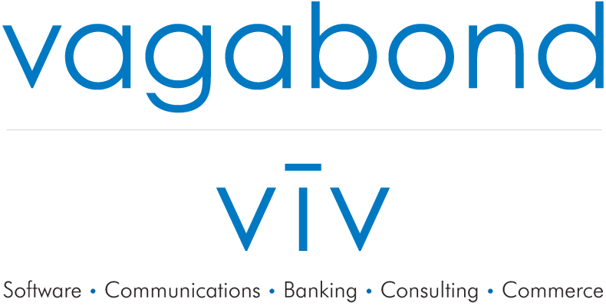

Slide 2
Embracing Technology and
the Millennials that Love It!
The New Barbarians at the Gate
or
the Heroes of Vending?

Slide 3
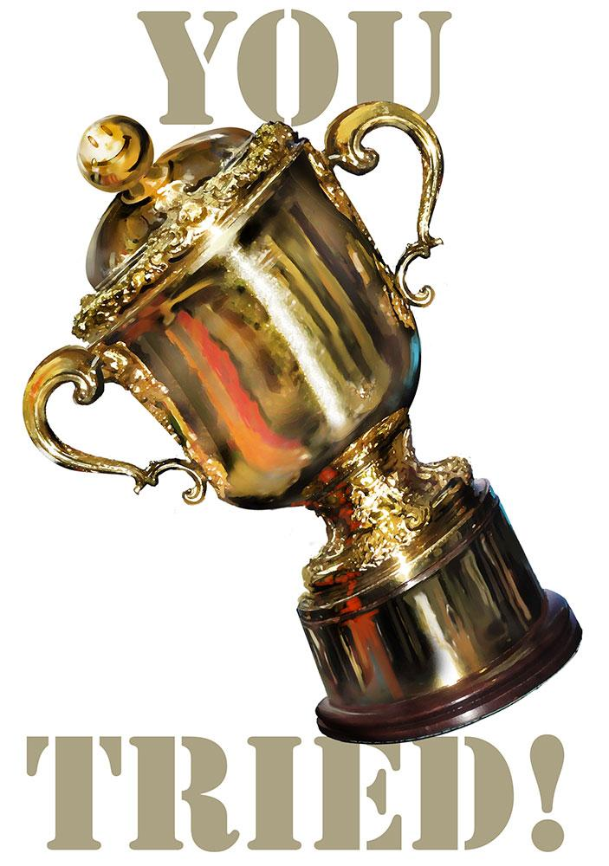
What do we think about Millennials?
…….FAIR? Right?
Notes:
Changed the way consumers interacted with the vending machines

Slide 4
Millennials?
Here’s my conclusion upfront:
Millennials are going to provide vending with the best growth and profit opportunity in decades!
I’ll be focused on this point throughout the presentation!
Notes:
Changed the way consumers interacted with the vending machines

Slide 5
Let’s talk about our own “house” to get a bigger picture, then return to Millennials!
Disrepair - the state of needing to be repaired : bad condition
The lighthouse was in disrepair until volunteers cleaned it up. A number of major bridges are in (states of) disrepair.
After years of neglect, the house fell into disrepair.
Vending machines are one of the few things keeping us away from the dream of a cashless society. The devices, which offer up an array of items for a little bit of pocket change, are silent but prevalent., Atlas Obscura, August 2015.
Notes:
Changed the way consumers interacted with the vending machines

Slide 6
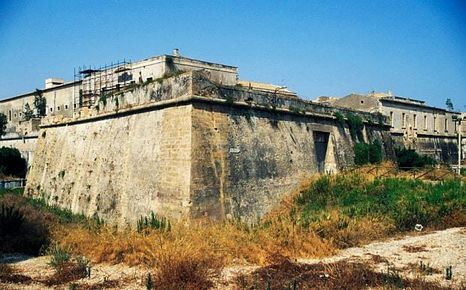
Swabian Castle in Sicily
Built in the 1240’s by the Holy Roman Empire and used in World War II by Germany AND stood strong until 2016...the State government took the landmark away from the City government for disrepair...800 years later...

Slide 7

Parts of the Great Wall of China
Qiao Guohua patrols 5-mile stretch of the Great Wall of China. About a third of wall's 12,000 miles have crumbled to dust, and saving what's left may be world's greatest challenge in cultural preservation. Why? Forgot this part – disrepair!

Slide 8

Bad neighbor next door...oops...

Slide 9
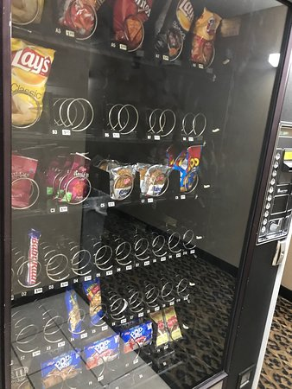
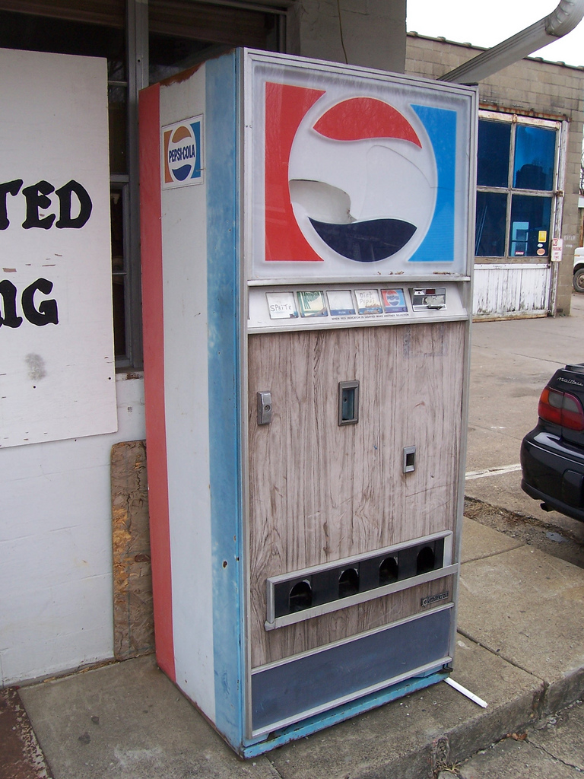
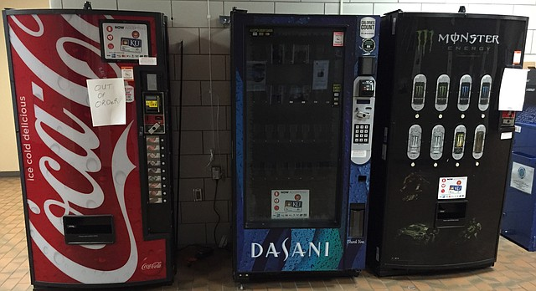
How about our vending machines? Disrepair?

Slide 10
Vending Machines? Your business? Let’s be honest! Are you embracing technology?
It’s the key to Millennials….
What’s needed?
Have you evaluated your business?
“Counted the cost”?
Are you upgraded to MDB and DEX?
Why or why not?
What’s the fear?
Vending Technology is the key to your business AND...
I’m not saying this for Me. I’m talking US!!! My…err our….industry – Vending! Our current future is today….this is where we go back those guys, Millennials! Let’s start bringing it full circle.

Slide 11
Confused, yet? What do Millennials and disrepair have to do with Technology?
Everything…Our future depends on the “next” generation.
  Baby Boomers retiring in faster numbers (youngest 53)
    Gen X showed they didn’t “jump on vending”
Millennials…
...Now what do we do?
Millennials are the one and only customer group that we say, “Sorry! YOU have to adapt to us in order to use our products or services.”
Notes:
Changed the way consumers interacted with the vending machines

Slide 12
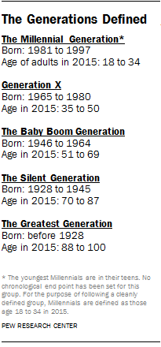
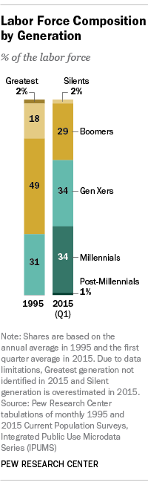
Generations Defined & the Labor Force

Slide 13
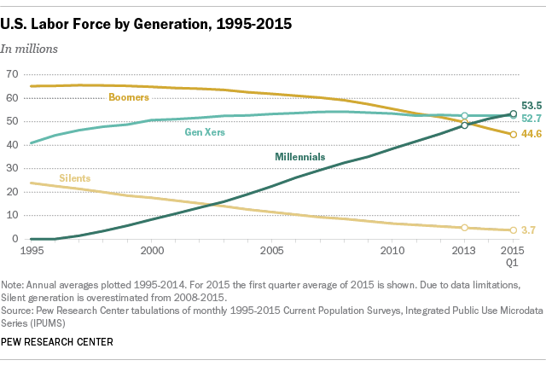
Millennials represent the largest generational group in the US workforce as of 2015, surpassing baby boomers and largest generational group in the US population as of 2016. Are they taking over?

Slide 14
Changes due to Millennials...By 2020, Millennials will represent ~50% of the U.S. Workforce
Three main changes...open our eyes!
Familiarity with technology and data analysis
  They don’t fear the Internet. There is data at their fingertips and know how to find it. What’s that mean? New is now. Don’t fear new. In sales, where performance depends on skillful interpretation of existing data sets, this makes millennials indispensable. They can train us! iPhone launched in 2007! Millennials grew up with Internet, cellphones, WiFi, and now instant anything.
Independent mindsets
  Strength - Millennials demand social justice and social responsibility from corporations, and are willing to pursue new ideas than follow traditional models. Embrace change!
Flexibility in communication
  73% of millennials prefer email as primary mode of communication, compared to phone calls or in-person meetings, due to speed, trackability, and ability to grant users forethought when speaking.
...Businesses have to adopt new practices to connect or we will lose! Are we ready to accept the opportunity?
Notes:
Changed the way consumers interacted with the vending machines

Slide 15
Millennial Mindsets
Frequent technological change is a simple fact of life
Used to living in unpredictable conditions (Recession, terrorism, fear of climate change), sharing all aspects of their lives online, and having the world at their fingertips.
They see the world as a small, highly connected ecosystem! They want to trust brands and will share data (more than any generation), but want to be rewarded with personalized service.
Community isn’t localized (city, state, etc.) It’s about the connected community (Facebook, LinkedIn) and shared interests. That’s where they go to choose products!
Banking & Payment methods - they’ll change these for better “experiences”, not face-to-face connections! New & emerging will win!
Millennials are looking far beyond checks and traditional electronic methods
Notes:
Changed the way consumers interacted with the vending machines

Slide 16
Millennial Mindsets continued
Checks and traditional electronic methods such as cards and ACH transactions - overlooked. Over 50% are already using or considering non-traditional payment methods. 2x as likely as those over 35 to use mobile payment applications, and 21% have never even used a paper check to pay a bill.
18-24 yr olds spend an average of 5.2 hrs/day on their smartphones.
For millennials and Generation Z, payment is just one element of a larger, more holistic goal like buying coffee at Starbucks, paying fare for a ride-sharing service like Uber, or making the monthly car payment. These next-generation customers expect to embed their bank into everyday purchase flows; how the money actually moves is irrelevant. They believe transactions should occur automatically and in real time, as part of the larger digital commerce universe.
Think about the race to payments – Android Wallet, Google, Samsung, Apple…...
Notes:
Changed the way consumers interacted with the vending machines

Slide 17
So… Cash is dying and Cashless is Key!
Benefit for us? Yes - Cash is expensive
Counters (machine)
Security truck to pick up cash isn’t free
Theft - from employees and non-employees
Bank fees
Insurance
Machine damage...stolen truck?
Coin and bill repair and complaint calls - 70%+ of costs of management of equipment - Ouch!!!
Adding Cashless = Reduces costs! Not just added sales!
Mobile apps are a solution to higher costs!

Slide 18
Cashless World?
American adults under age 35 “hate” cash so much that 51 percent of them will use plastic, even for purchases amounting to less than $5.
62% of Americans surveyed in a June 2016 Gallup poll predicting a cashless society in their lifetime, most agree cash is going the way of the dinosaur.
28% of Americans ages 18 to 49 say that they make none of their purchases using cash in a typical week, compared with 20% of those ages 50 and older.
Americans under the age of 50 say that they don’t really worry about having cash on hand due to the range of other payment options available to them: 45% of 18- to 49-year-olds, compared with 31% of those 50 and older
Today most VENDING does NOT connect to the “mass market” (err…Millennials) with 80% requiring CASH & COIN.
Millennials LOVE vending. Outsiders are coming into vending to fill that gap - Best Buy, ULTA, Proactive and other new entries into vending.
Notes:
Changed the way consumers interacted with the vending machines

Slide 19
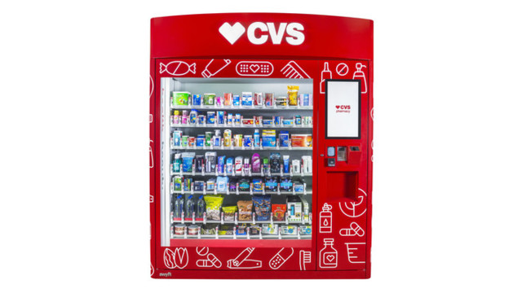
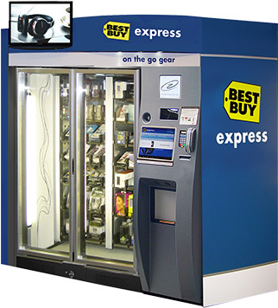
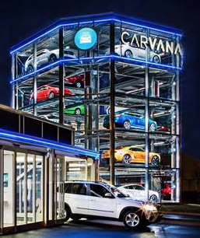
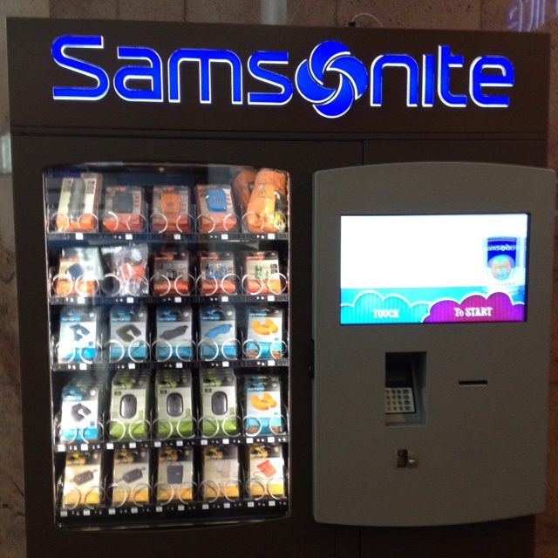
Notes:
Changed the way consumers interacted with the vending machines

Slide 20
Millennial TRUE Story
THIS Week….
I was sitting at a bar writing THIS presentation. The bartender (32) asked me what I was writing about – “Millennials”. He said, “I’m a Millennial….”
After talking to him and sharing some notes (i.e. testing my study)…..he shared a story about his sister (24). Her beats headset wasn’t working, so she needed a new headset. Beat headsets are $200. He told her that he’d take her to Best Buy for a new set. She told him to take her to the airport instead, same distance. He took her. She ran in and came out with a new Beats headset. She would rather go the vending machines at the airport then to Best Buy to avoid people and make it “quick and easy”. $200 in a vending machines!!!
Notes:
Changed the way consumers interacted with the vending machines

Slide 21
Can I piece it together?
Yes. Millennials are the heroes of vending
Force positive change with technology (i.e. remove our disrepair)
  VMS – connectivity
  Cashless - connectivity
Loyal to the NEW and exciting…
Love vending (cannot say that enough)
Want vending to be a fun and rewarding experience
Cash is dying and it’s a cost with decreasing value
Millennials don’t use cash!
Technology is Good. Embrace the push!
Notes:
Changed the way consumers interacted with the vending machines

Slide 22
Ok so what do Millennials need?
Connectivity to brands...YES, Your business is a brand, not just the products
Connectivity to ease of payment (i.e. not cash)
Connectivity to their preferred purchasing location(s)
Want to KNOW that Mr. Vending Guy is green(er), which you are with technology
Experiences
  Loyalty & Rewards
  Gamification
  Expectations/Satisfaction
  Variety, Adaptability, Flexibility
Notes:
Changed the way consumers interacted with the vending machines

Slide 23
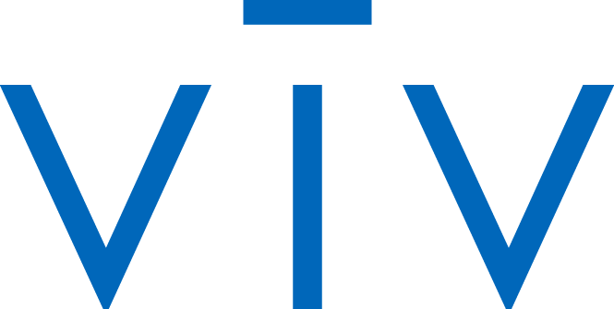
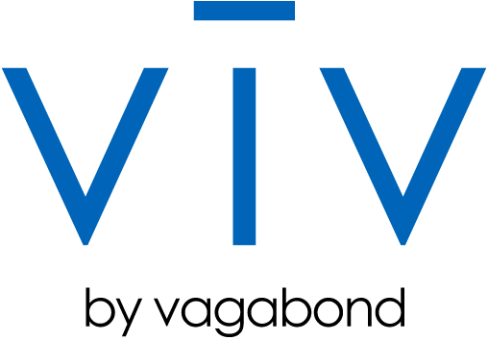
How to re- vending
Bear with me. This is NOT a commercial. This is an agnostic solution. We decided to partner with our competitors for the good of the industry!
Notes:
viv, a revolutionary new payments service that lets you buy things from machines and pay any way you like.
Instant mobile transaction.
Without touching the machine.
Truly e-commerce transactions but happening in real-life right in front of your eyes.
Vagabond is now deploying IoT hardware that accepts VIVE payments.
This is going to enable us to link buyers, sellers, and makers of goods in ways previously impossible in retail.
And we’re driving a significant portion of the smarts through Google APIs

Slide 24
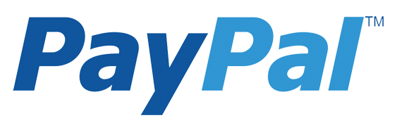
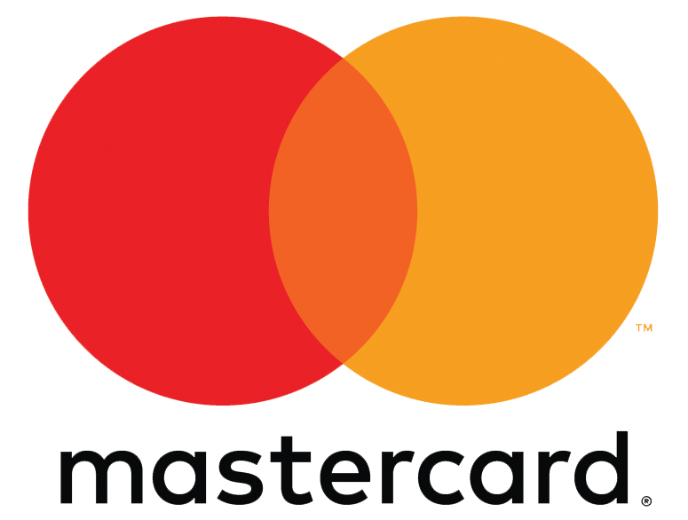

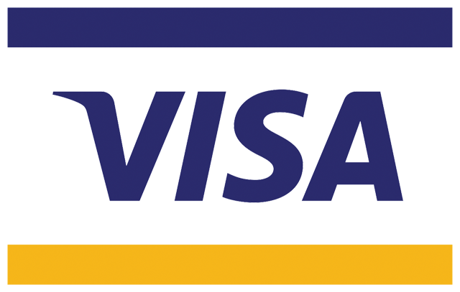
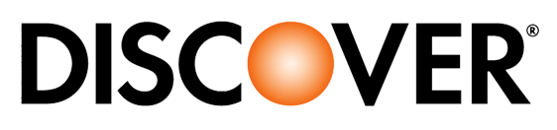
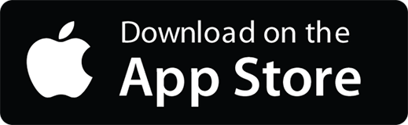
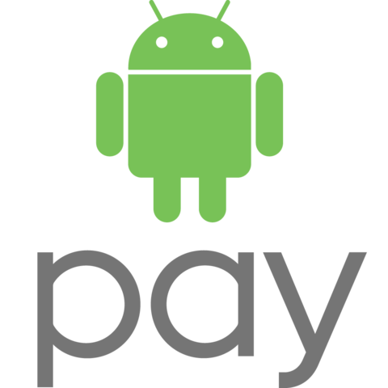

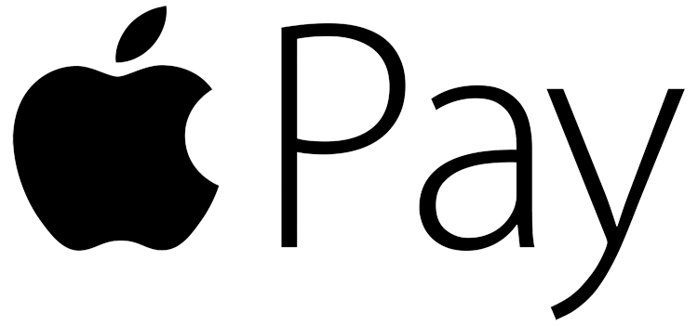
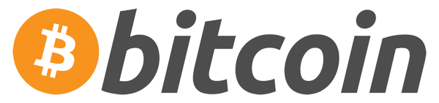
How to re- vending
Instant Mobile
Transactions at Machines
Touchless
Purchasing
E-commerce
in Real Life
Linking Buyer, Sellers, & Makers of Goods
Notes:
viv, a revolutionary new payments service that lets you buy things from machines and pay any way you like.
Instant mobile transaction.
Without touching the machine.
Truly e-commerce transactions but happening in real-life right in front of your eyes.
Vagabond is now deploying IoT hardware that accepts VIVE payments.
This is going to enable us to link buyers, sellers, and makers of goods in ways previously impossible in retail.
And we’re driving a significant portion of the smarts through Google APIs

Slide 25
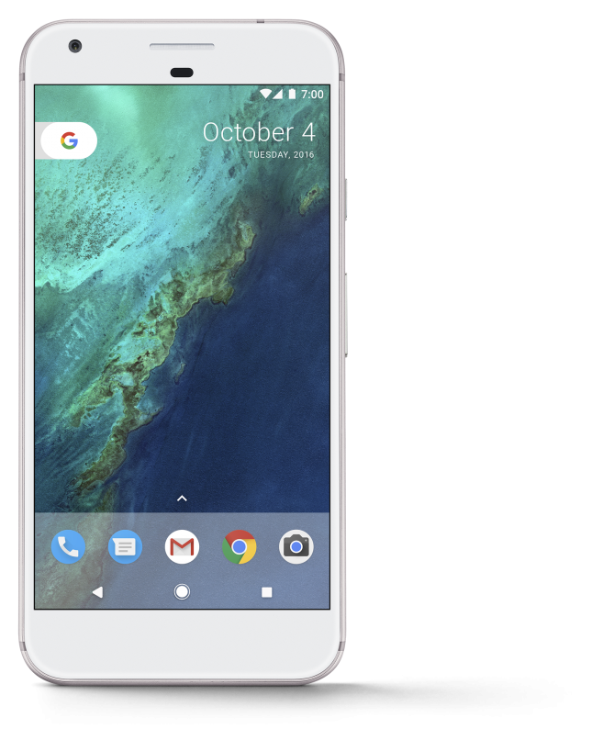
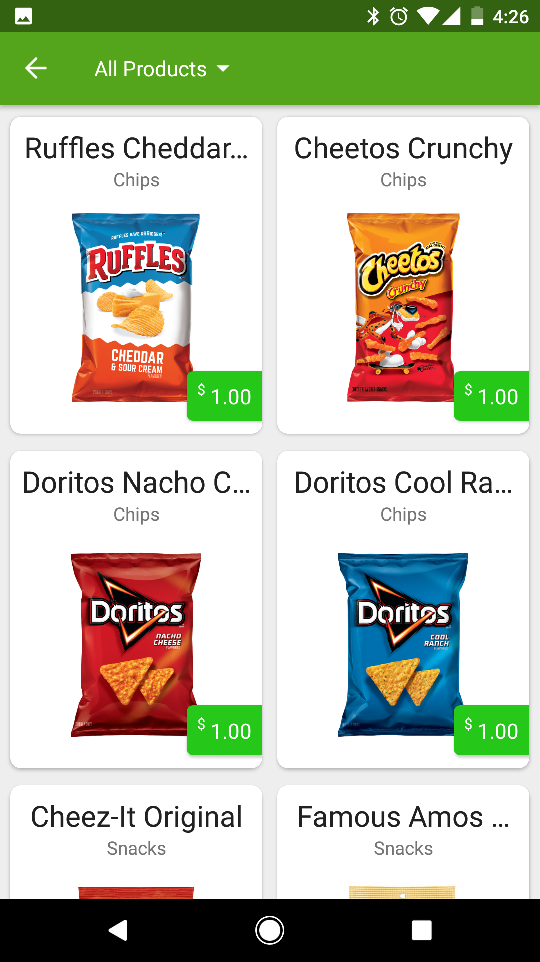
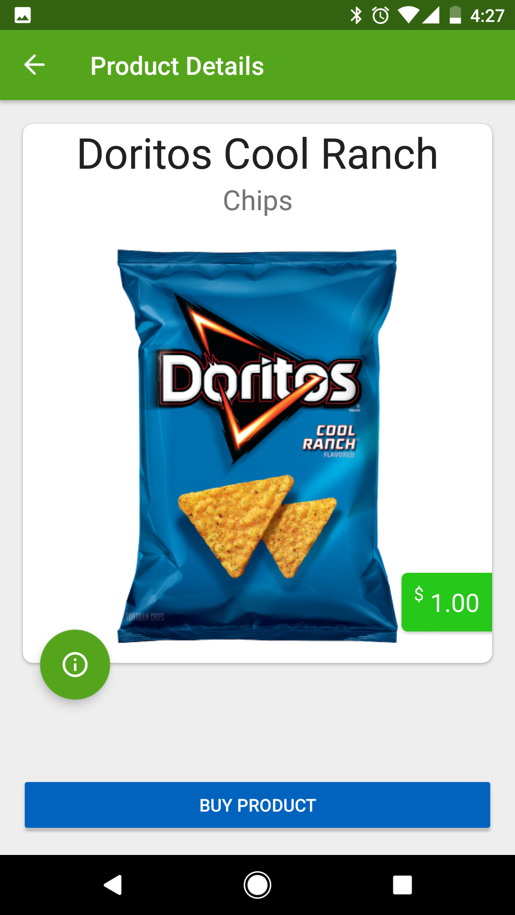
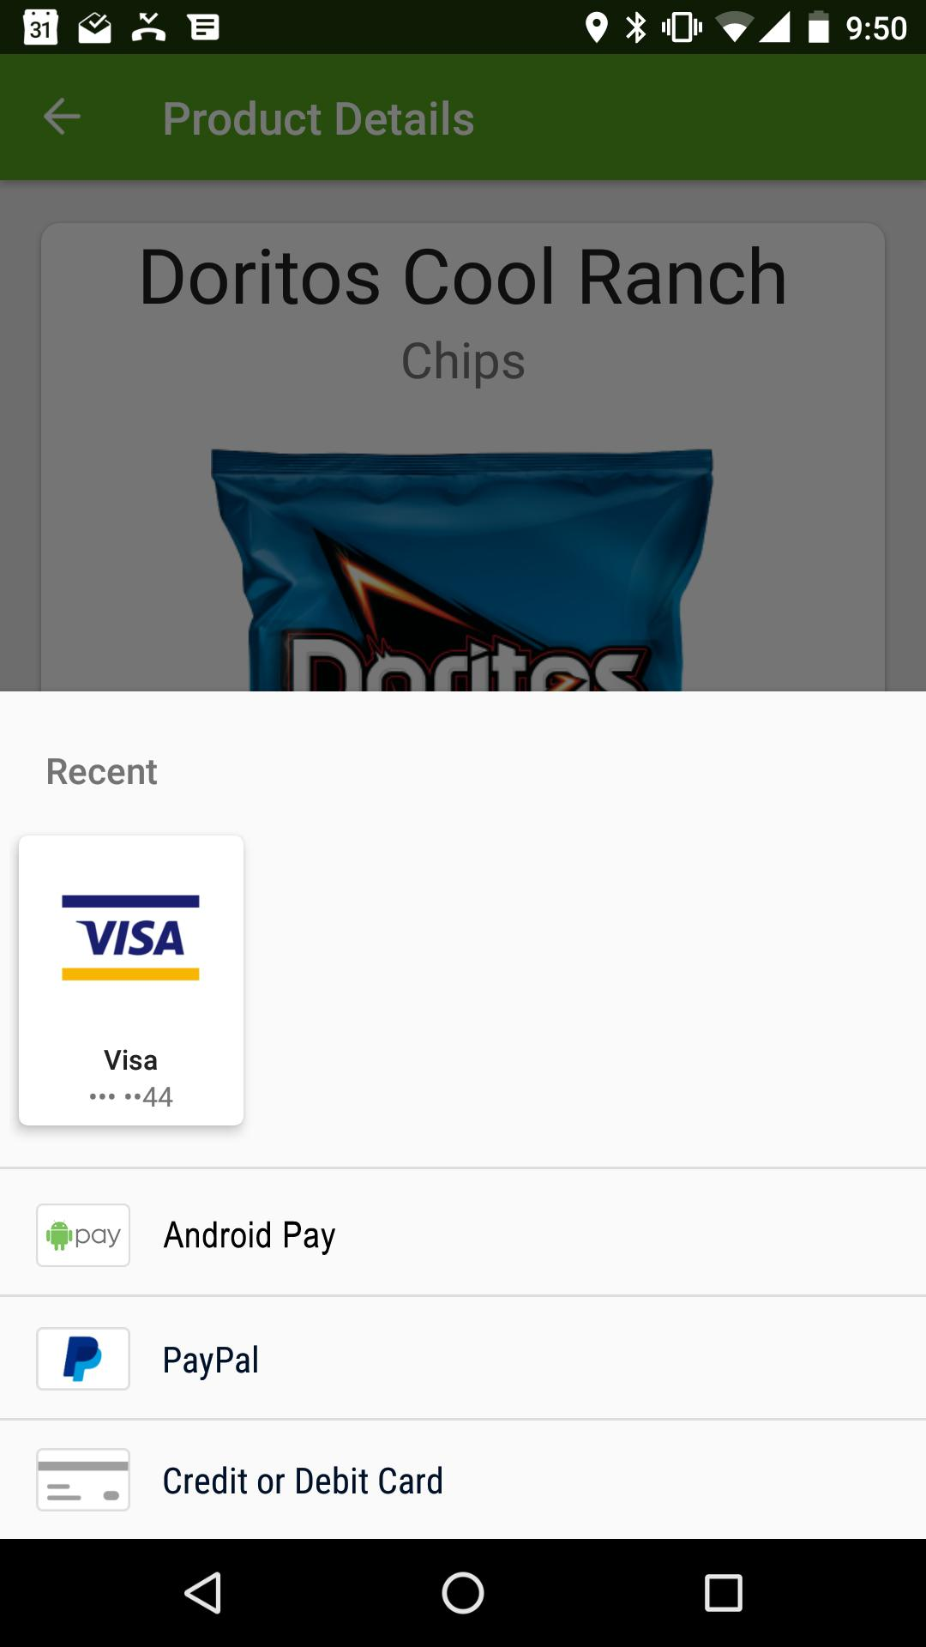
Scroll Menu
View Details
Choose Payment
Notes:
Just open the app and connect to a machine
select from a menu of items
View nutritional, loyalty, promotional details
Select your payment type
And the product drops
No touching the machine
No NFC required
No POS terminal
No teller
This product is about to be released to an industry who counts the acceptance of a dollar bill as one of its greatest innovations of the last 40 years.
All for ⅓ the TCO of traditional card payment systems.

Slide 26
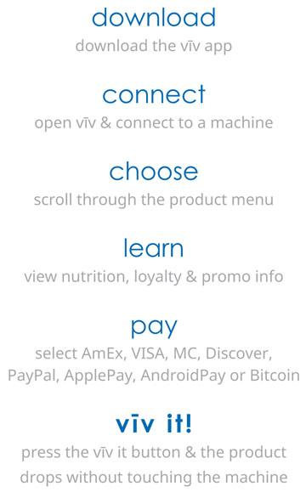
No stored value -
Millennials hate stored value
No hardware purchase
Touchless vending experience
Flexible payment options
Instant data transfer to VMS
5.95% cashless transaction rate
49% of consumers at locations use mobile to pay
Notes:
What is viv?
Does it work with my VMS?
What payments does it take?
How will this help ME?
WHY?

Slide 27
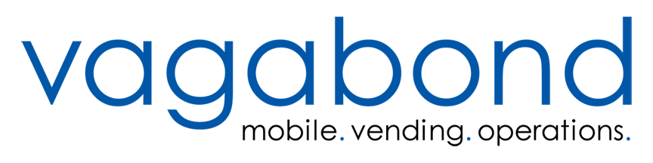
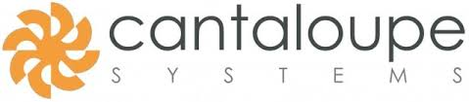


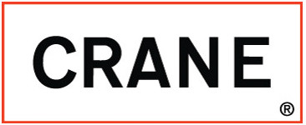

The Offering
Cashless, hardware, telemetry, VMS
Vagabond Insight hardware
Choose your VMS
Choose your machine

Slide 28
Millennials ARE the Heroes of the Vending Industry
Millennials are our clients today. They are an awesome opportunity to kill our “disrepair” and upgrade to profitability.
We need to adapt to our clients in order to continue to win in business. Millennials are going to be 46% of employees by 2020.
Technology is our friend and a REAL friend of Millennials.
  VMS = great profitability
  is a tool for all operators to connect with Millennials.
Embrace both for a winning business…
…. and a growing future!
Notes:
Changed the way consumers interacted with the vending machines

